Slide 1

SCIENCE 6 (Describing Mixtures)
Quarter 1
Week 1 – Day 1

Slide 2
Content Standard
The learners demonstrate understanding of different types of mixtures and their characteristics

Slide 3
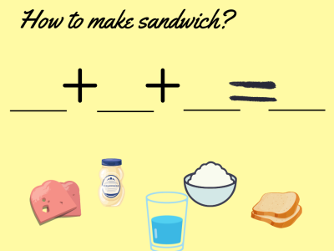
Motivation:
Have you tried to make a sandwich? How can we make a sandwich? Can you arrange the ingredients below?

Slide 4
What have you notice in our activity? Can you give another example of foods that can be mixed? Share it in our class.

Slide 5
Let us learn about describing mixtures.

Slide 6
Discussion
Mixtures are combinations of two or more substances that can be homogeneous or heterogeneous. Homogeneous mixtures appear uniform all throughout because they have the same proportion. Heterogeneous mixtures are not uniform in proportion where combined substances are not evenly spread or mixed.

Slide 7
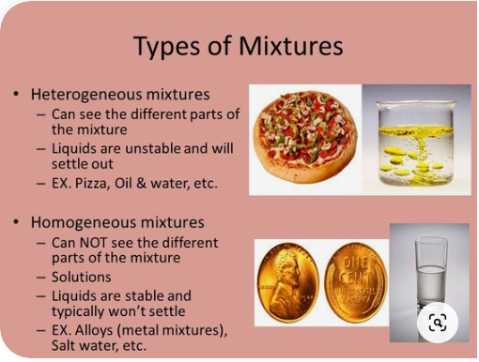

Slide 8
Instruction: From what we have discussed about mixture, answer the following question to your journal.
1. How will you define mixture?
2. What are the 2 types of mixtures? __________ and ___________.
3. How can you differentiate the 2 mixtures? Explain your answer.
4. Give at least 2 example of each mixture.

Slide 9
Discuss the concept of the lesson.

Slide 10
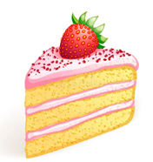
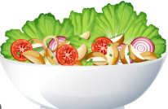
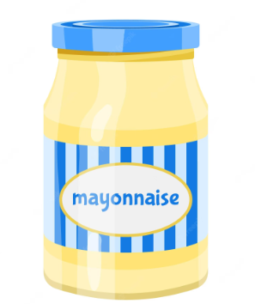
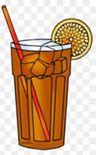
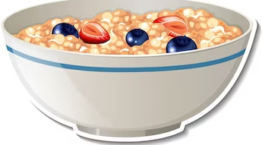
Instruction: Identify if the following mixture is homogenous or heterogeneous.
1.
2.
3
4.
5.

Slide 11
Instruction: Classify the following mixture Write HO for homogeneous mixtures and HE for heterogeneous.
1. milk
2. alloy
3. smoke
4. seawater
5. vinegar
6. syrup
7. soil
8. water
9. plastic
10. muddy water

Slide 12
SCIENCE 6 (Describing Mixtures)
Quarter 1
Week 1 – Day 2

Slide 13
Can you give an example of mixtures?
From the examples, what are the heterogeneous and homogenous mixtures?

Slide 14
Let’s experiment.
Combine the two mixtures
1. oil and water
2. sugar and water

Slide 15
Let’s observe:
What have you observe from the two mixtures? Explain your answer.

Slide 16

Let’s do this.
Prepare solid and liquid materials that the learners will mixed.
Ask the pupils to combine two substance and list the mixture on the board. Identify if it is heterogeneous and homogeneous.

Slide 17
Discuss the answers of the pupils.
Let them explain their answer for understanding.

Slide 18
Mixtures are combinations of two or more substances that can be
homogeneous or heterogeneous. Homogeneous mixtures appear uniform all
throughout because they have the same proportion. Heterogeneous mixtures
are not uniform in proportion where combined substances are not evenly
spread or mixed.

Slide 19
Instruction: Read and answer the following. Write the answers in your journal.
1. What are the different forms of mixtures?
2.Jelly, mixed the two mixtures like coffee, sugar, and water. Is it Heterogeneous or Homogeneous? Why?
3. Shiela, combined the different vegetables to make a salad. Is it Heterogeneous of Homogeneous? Why?

Slide 20
Mixtures are combinations of two or more substances that can be
homogeneous or heterogeneous.

Slide 21
Instruction: Choose the best answer in the following questions.
1.There are two types of mixture. What are those?
a. solid and liquid
b. Liquid and gas
c. heterogeneous and gas substance
d. heterogeneous and homogeneous

Slide 22
2.What is the best definition for heterogeneous?
a. We cannot distinguish their components.
b.It is made of solid and liquid substances.
c. It is made of liquid and gas substances.
d. we can distinguish their components.

Slide 23
3.Which of the following mixtures which components are easily identified?
a. juice drink
b. hot chocolate
c. hot coffee
d. taho

Slide 24
4.Joana made a colored water what kind of mixture is colored water?
a. heterogenenous mixtures
b. solid and liquid mixtures
c. homogeneous mixture
d. gas and liquid mixtures

Slide 25
5.Janice, cooked a delicious dish called Caldereta, you can see the ingredients in her dish. What kind of mixture is the Caldereta?
a. heterogeneous
b. homogeneous
c. solid and liquid
d. gas and liquid

Slide 26
SCIENCE 6 (Describing Mixtures)
Quarter 1
Week 1 – Day 3

Slide 27
Mix a substance that will turn into homogenous mixture.
1. ___ + ___ = ___
2. ___+ ___ = ____
3. ___+ ___ = ____
4. ___+ ___ = ____
5. ___+ ___ = ____

Slide 28
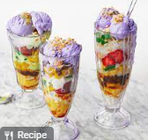
Look at the picture and describe it.

Slide 29
Let us learn more about describing mixtures.
Halo-halo is an example of a mixture. A mixture is a substance made by mixing other substances together. When two or more elements or compounds mix together, not necessarily in a definite ratio and do not interact chemically, then the resulting substance is known as a mixture.
In Figure 1, can you identify the components or ingredients that were combined to make halo-halo? What are these materials?

Slide 30
In this kind of mixture, you can distinguish some pieces of corn, banana, beans and other materials that make up the mixture in halo-halo. The mixed materials can be classified depending on the appearance of the resulting mixture. Each of the combined/mixed materials can be identified or distinguished from one another. This kind of mixture is called heterogeneous mixture. Each property of the materials in heterogeneous mixtures do not change.

Slide 31
Types of Mixture
There are two types of mixtures. One is homogenous mixture which contains substances that are evenly mixed and is uniform throughout in terms of physical appearance. The other one is heterogeneous mixture which contains component substances that are usually easy to distinguish.

Slide 32
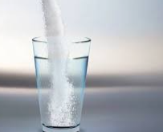
Examine the pictures in Figure 2. Can you identify the materials that make up these mixtures?

Slide 33
Discuss the concept of the lesson.

Slide 34
List down 5 heterogeneous mixtures found around us and identify the substances contained in the mixtures. Use a table.
Mixture | Substances

Slide 35
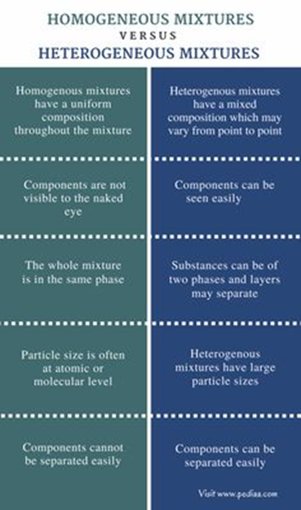

Slide 36

Instruction: Complete the Venn diagram. Write the differences and similarities of two mixtures

Slide 37
SCIENCE 6 (Describing Mixtures)
Quarter 1
Week 1 – Day 4

Slide 38
Let’s mix!
Mix a substance that will turn into heterogeneous mixture.
1. ___ + ___ = ___
2. ___+ ___ = ____
3. ___+ ___ = ____
4. ___+ ___ = ____
5. ___+ ___ = ____

Slide 39
Give another examples of solid homogeneous around you.

Slide 40
Homogeneous mixtures have uniform composition where the substances are evenly mixed. They are also called solution. In its component, the substance that dissolves or seems to disappear is called a
solute while the one that dissolves is the solvent.

Slide 41
Most of the time, the formation of this kind of mixture is associated with the process of dissolving. We say soluble if the solid solute completely dissolved in the liquid solvent and insoluble if it is not. While if the components are both liquid, the term miscible or immiscible is used. Salt dissolves in water. Salt is the solute, and water is the solvent. This property of solutes is called solubility. It is measured in the amount of solute that can dissolve in a fixed amount of solvent. Air is an example of gaseous solution. Metal alloys are examples of solutions in the solid phase. Ammonia water is a liquid solution made up of ammonia gas dissolved in water. Ammonia gas is the solute and water is the solvent.

Slide 42
Discuss the concept of the lesson.

Slide 43
List down 5 homogeneous mixtures found around us and identify the substances contained in the mixtures. Use a table.
Mixture | Substances

Slide 45
Instructions: Let’s reflect on our discussion. How can you use these lessons in real life situation?

